Slide 1
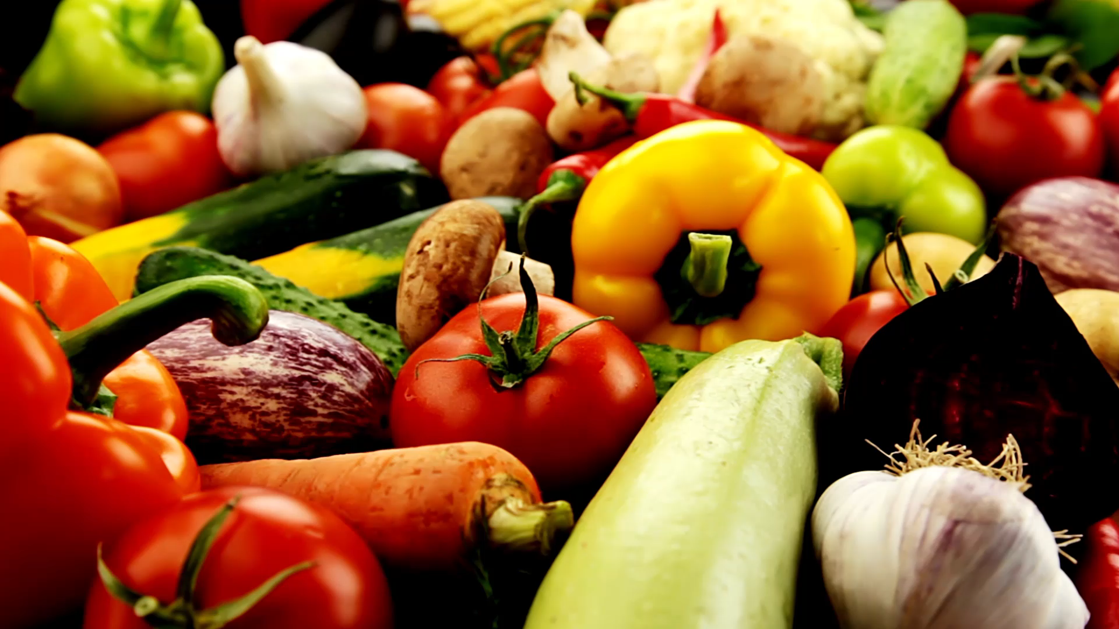
Promoting Healthy eating & balanced diet

Slide 2
Agenda:
TEAM MEMBERS
PROBLEM STATEMENT
PROJECT DESCRIPTION
PERSONAS
MINIMAL VIABLE PRODUCT (MVP)
TECHNOLOGIES
ARCHITECTURE DIAGRAM
PRODUCT & SPRINT BACKLOG
METRICS
RETROSPECTIVE

Slide 3
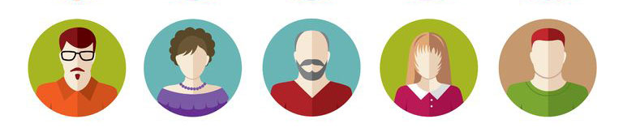
Meet the team

Slide 4
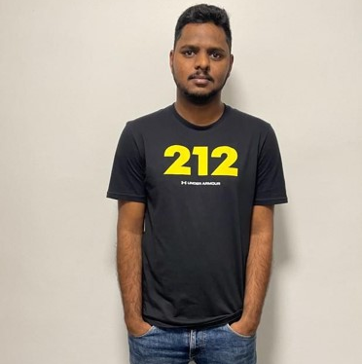


SATHWIK MUDENTI
VARUN REDDY DUGGIMPIDI
NARESH BABU CHINTA
BACKEND DEVELOPER
BACKEND DEVELOPER 2
QA/TESTER

Slide 5

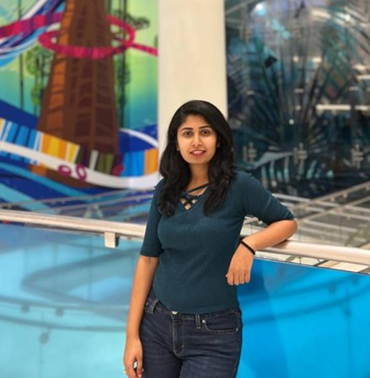
Dharini Maanasa
BRUNDA REDDY
FRONTEND DEVELOPER
DATA ADMINISTRATOR

Slide 6
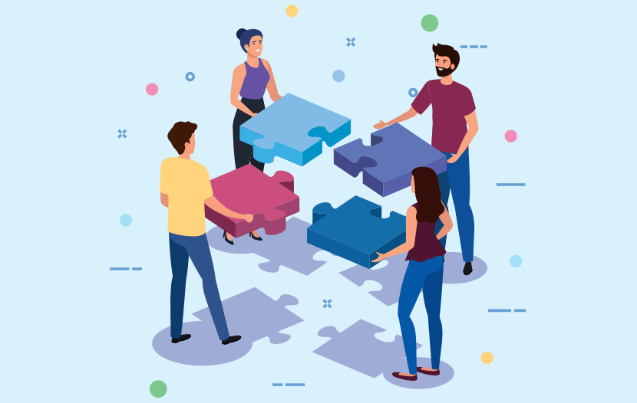
RESPONSIBILITIES

Slide 7
We makes sure team has clear objectives of the project.
Make a list of all the tasks that need to be completed.
Being engaged and stay committed to submit deliverables on time.
Encouraging each other to complete the tasks given.
Understanding what is expected and what needs to be delivered.
Making sure every teammate providing the equal amount of contribution.
Providing the feedback within the team to perform better.

Slide 8

IMPROVEMENTS MADE FROM PROFESSOR FEEDBACK
Our initial project idea was very basic and as suggested by the professor, we have come up with a new project proposal which is “Promoting Healthy Eating & Balanced Diet.
We also decided to change the tools and technologies involved in the project as our previous technologies were primitive.

Slide 9

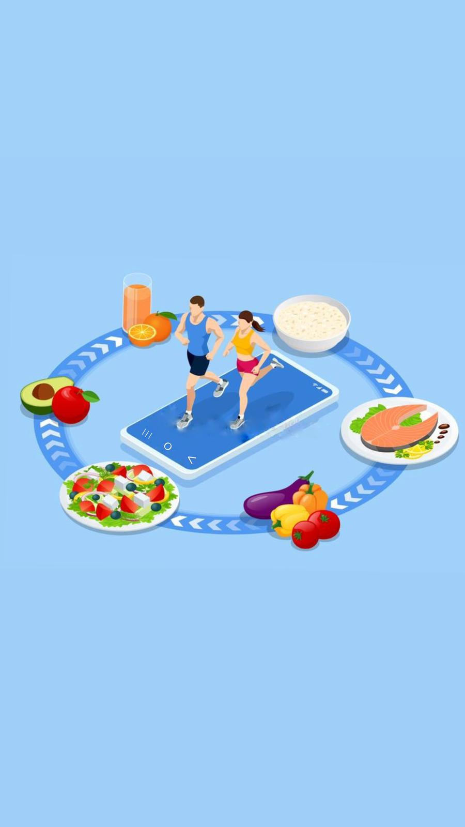
PROBLEM statement

Slide 10
The project focuses on four major problem statements:
Food Classification.
Recipe Generation.
Balanced Diet.
Calorie Estimation.
From the image of food captured, we determine the classification of food (such as donut, samosa, biriyani), identify the calorie count and describe the cooking procedure of the food. With this information, an informed decision can be made on making the item or not.

Slide 11
Food Classification:
Food classification is a challenging problem due to the large number of food categories, high visual similarity between different food categories.
It’s multi-class classification problem to predict the 251 fine-grained food-category label given a food image.

Slide 12
Recipe Generation:
Recipe Generation problem is resolved by three major sub-networks.
Food understanding (Extracting ingredients)
Multi-label classification (Detecting the food title)
Conditional text generation (NLP)(Preparing recipe)
The pipeline extracts the image representation with resnet-50 encoder and obtain the ingredients. Recipes are generated with identified ingredients into human readable format.

Slide 13
Balanced Diet:
A balanced diet is one that contains all of the essential elements that the human body needs.
Carbohydrates, lipids, vitamins, minerals, proteins, fiber and water are all essential components in a well-balanced diet.
A nutritious, well-balanced diet lowers the risk of disease and enhances general health.

Slide 14
Calorie Estimation:
From the ingredients generated from Recipe module, we have computed the Calorie for the dish.
Each recipe provided us the nutritional value for every 100 grams.
Fat/ Saturation - Every gram of fat has 37 kilojoules.
Protein - Every gram of protein has 17 kilojoules.
Sodium - Every gram of sodium has 8 kilojoules.
Sugar - Every gram of sugar has 17 kilojoules.
Every kilojoule has 0.239006 calories.
Using this data we used the following formula to estimate calories.
0.24((fat * 37) + (protein*17) + (sodium *8) + (sugar * 17)) = total calories.

Slide 15
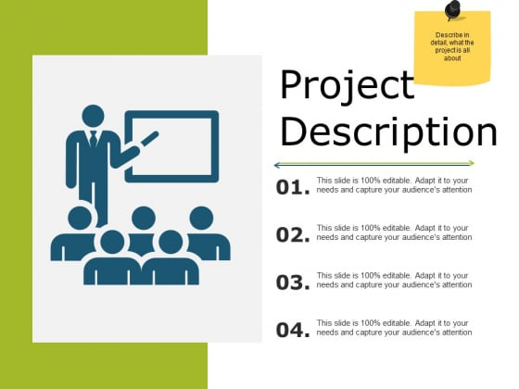
PROJECT
DESCRIPTION

Slide 16
People like to taste different cuisine and choose the most appealing food. They often are concerned about diet restrictions such as gluten-free, vegan, ketosis, peanut-allergy, and calorie count.
We would like to provide an easy solution to making health and good foods that fit your daily calorie consumption limit.

Slide 17
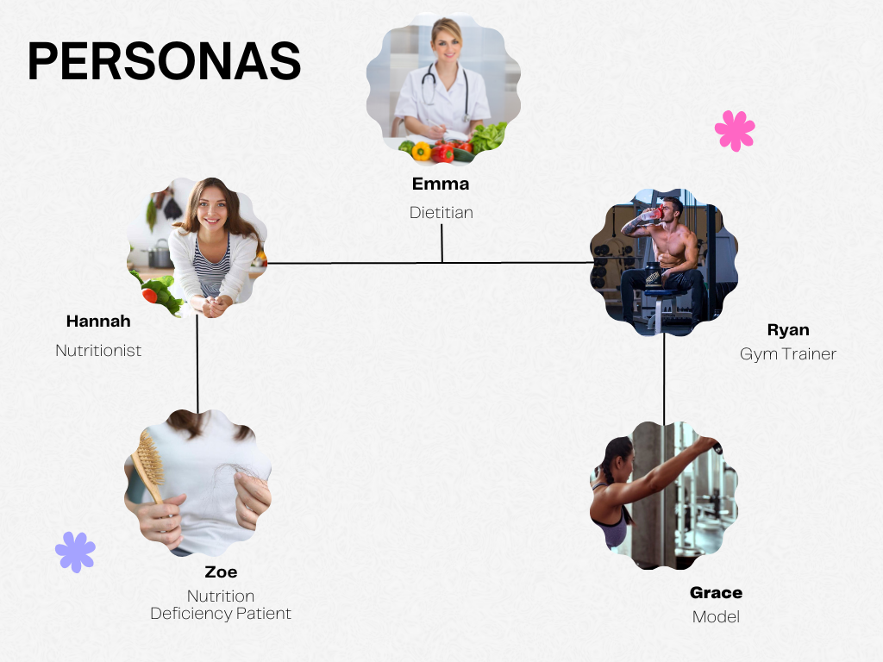

Slide 18

Emma
Dietitian
Emma is an expert Dietitian.
She is 33 years old beautiful dietitian.
She is a qualified health professional who helps
To promote good health through proper nutrition habits.
She is registered with the Commission of Dietetics Registration (CDR)
She has a license to practice as diet and nutritional consultant.

Slide 19
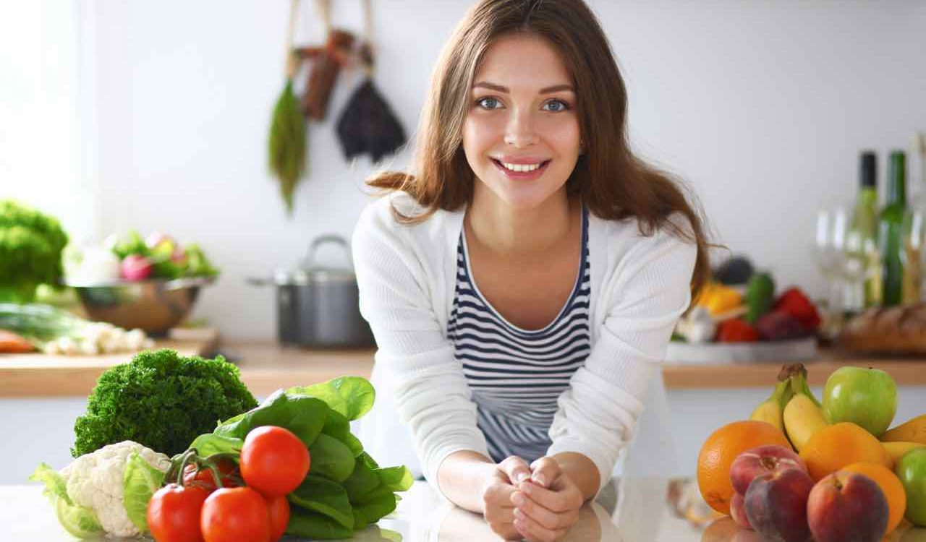
Hannah
nutritionist
She is a certified Nutritionist .
She works with healthy people to promote healthy eating habits.
She helps in creating awareness to prevent diseases related to nutrient deficiencies.
She uses an online health assessments to curate a daily supplement routine tailored needs.
Hannah is smart enough to understand the people's health condition and helps to get medications, supplements to them.

Slide 20
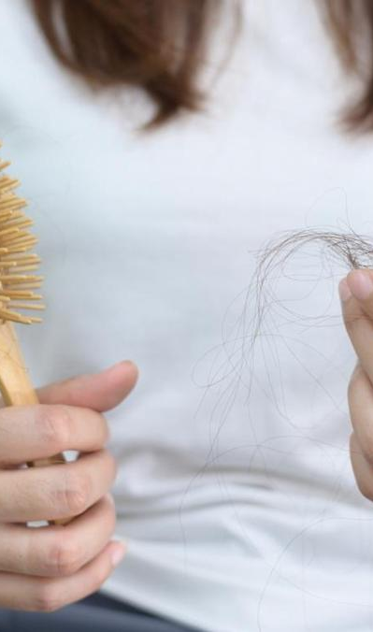
ZOE
Nutrition deficiency patient
Zoe is 24 years old who is suffering from Nutrition Deficiency
She has signs of B12 and suffering from dry skin, severe hair fall and brittle nails.
She need awareness about a good diet and healthy food habits.
She needs treatments including supplementation, change in diet, lifestyle and eating disorders.

Slide 21
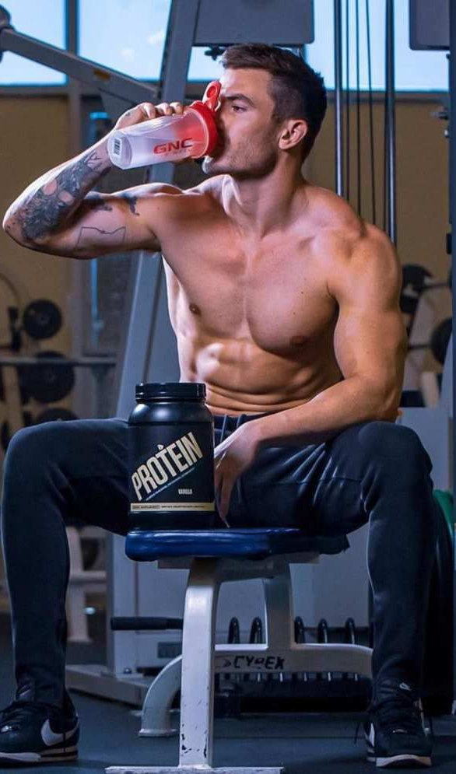
Ryan
Gym trainer
Ryan is a successful personal trainer in one of the best gyms.
He have a good knowledge about what his clients eat is as important as their training regimen.
He helps his client to reach their individual goals.
Ryan knows having the right mix of calories and macros from whole foods is most important.
So, he make an individual diet plan for his clients.

Slide 22
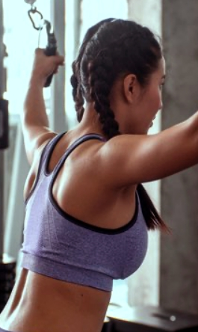
grace
MODEL
Grace is 22 year - young and an upcoming model.
Grace loves to be active and physically fit.
She is very much concerned about the food she eats.
She spends 2 hours a day in gym.
She follows a proper diet provided by her trainer.

Slide 23

MINIMAL VIABLE PRODUCT

Slide 24
Our project operates on a freemium model, providing nutritional and fitness advice from nutritionists and fitness coaches.
It is a basic, launchable version of the product that supports minimal yet must-have features which define its value proposition.
It is built with the intent to enable faster time to market, attract early adopters, and achieve product-market fit from early on.
Its development requires careful planning and a customer-focused mindset.

Slide 25









TECHNOLOGIES

Slide 26
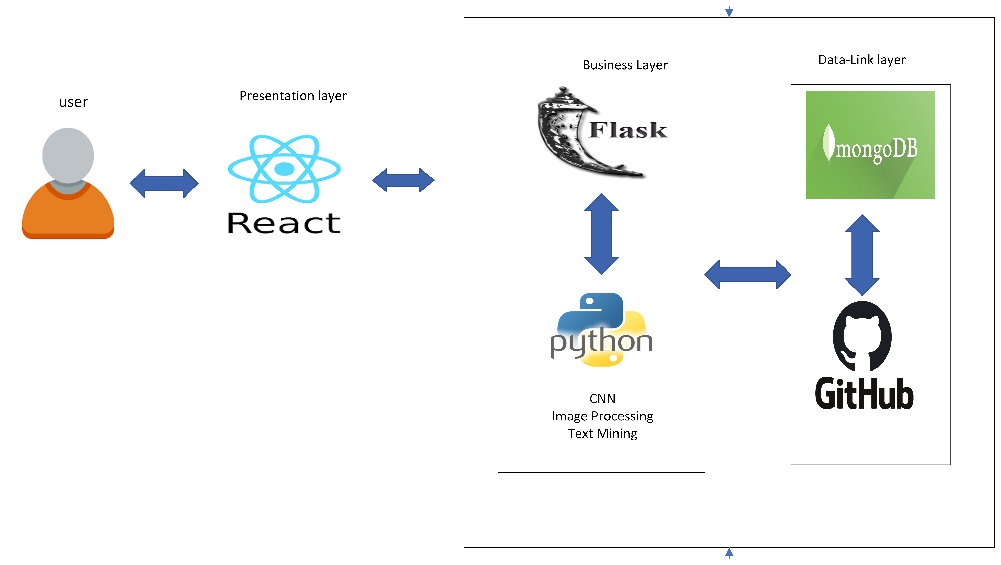
ARCHITECTURAL
DIAGRAM

Slide 27
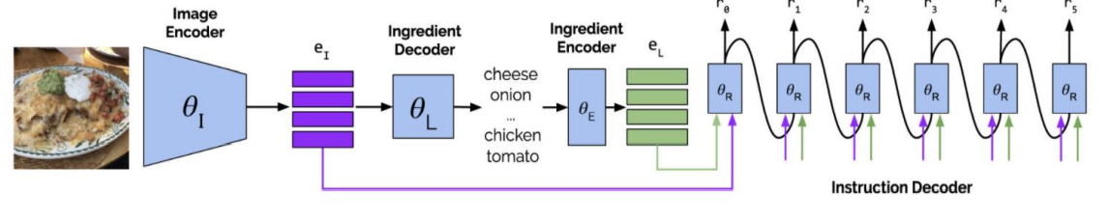
SEQUENCE ARCHITECTURAL DIAGRAM

Slide 28


PRODUCT BACKLOG

Slide 29
Food classification multi-class classification weights tuning.
Recipe generation pipeline setup was difficult with tensorflow, pytorch and Cuda dependencies version.
Calorie estimation is computed on raw vegetables which we fixed for cooking ingredients.
Merging the inference pipeline for three different modules.

Slide 30
USER STORIES
AND
ACCEPTANCE CRITERIA

Slide 31
Id | Acceptance criteria | Summary
SAT1 | As a new user I want to register using email So that I can login to the application | Scenario when user wants to register Given he registers Then his information gets stored And he can login using email and password
SAT-11 | As a new user I want to login to the application, but I enter wrong credentials So that I get alerted using a popup message that my credentials are invalid | Scenario when user wants to login Given he enters wrong credentials Then he gets notified by an alert to enter valid credentials. And the system asks him to enter right information
SAT-4 | As a new user I want to enter inputs like age, height ,weight ,activity so that I get recommendations based on my information | Scenario when user wants to give inputs Given he gives inputs and press submit Then his information gets stored And The system displays his information
SAT-5 | As a new user I want to navigate to all the services in the application So that I get familiar with all the services of the application | Scenario when user wants to navigate Given he wants to get familiar with all the services in the application Then user can get to know all the services in the application
SAT-6 | As a new user I want to navigate using a search on the web page So that I can navigate quickly | Scenario when user wants to navigate quickly Given he uses search-bar on top of the application Then he can navigate quickly using search-bar
SAT-9 | As a user I want to reset my password if I forgot one So that I can login again | Scenario when user forgets his password Given he changes his password Then the system stores his new password And he can login with his new password
SAT-8 | As a new user I want to edit my personal information So that I get recommendations based on changed information | Scenario when user want to edit his information Given the customer navigates to information. Then he changes his information. And he submits the information.

Slide 32
TEST CASES

Slide 33
Test case for sign-up
Test case | Test-data | output
Enter email | xyz@example.com
Enter password | Abc@123
Submit |  | On clicking submit if the email and password are valid then user is registered
Email validation | xyz@example.com | If email is invalid, it should prompt user to enter valid email
Password validation | Abc@123 | If password does meet required length or it is not strong enough user isa asked to enter strong password
Test case for Log-in
Test cases | Test data | Output
Enter Email | Xyz@example.com
Enter password | Abc@123
Click Login |  | After clicking log-in the user is logged in to home page .If email or password is not matched with registered information then user is prompted to enter correct information

Slide 34
SPRINT BACKLOG

Slide 35
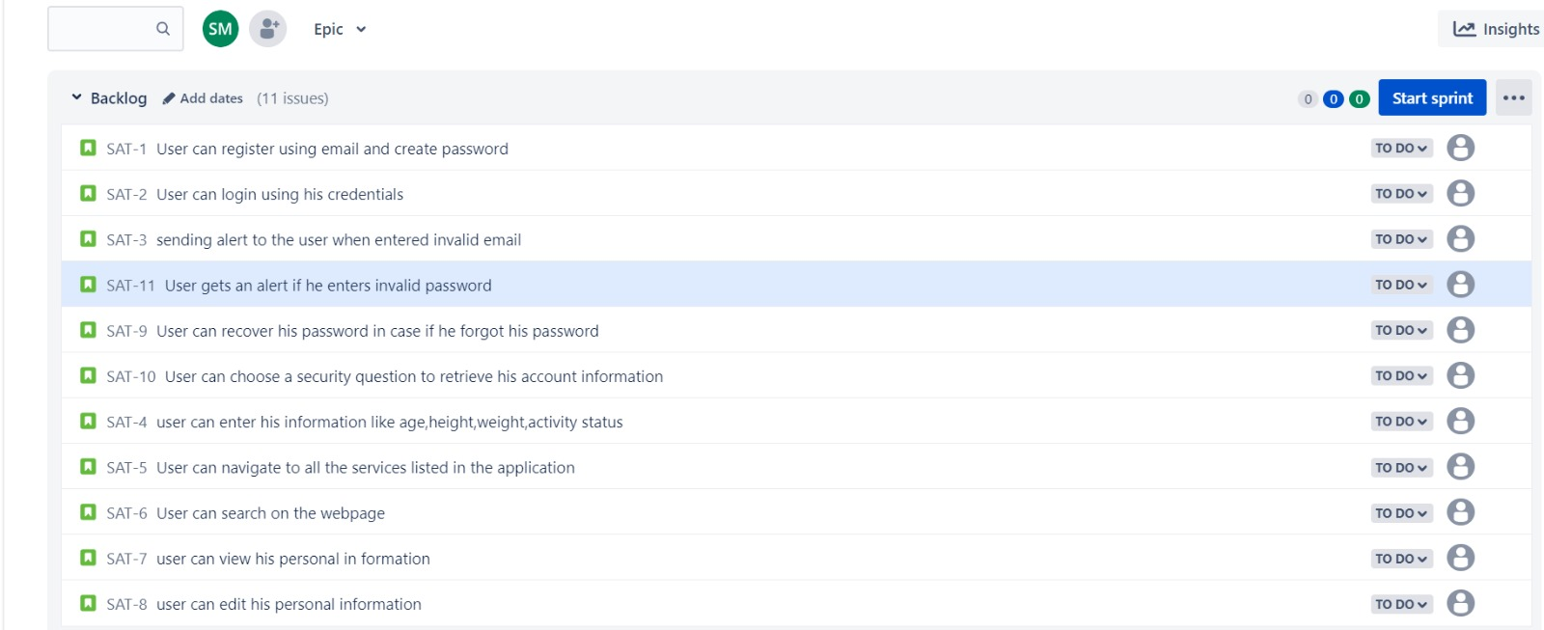

Slide 36

METRICS

Slide 37
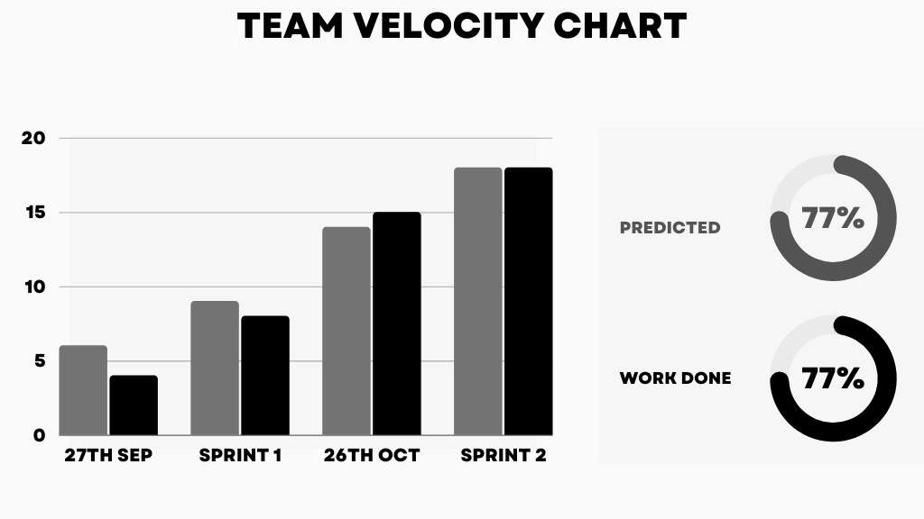

Slide 38
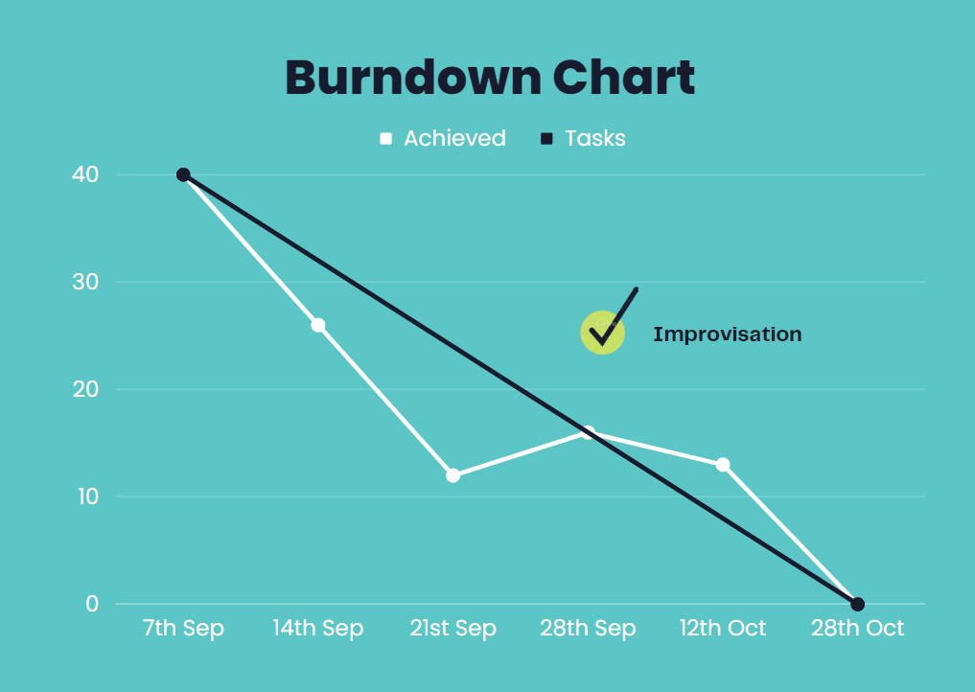

Slide 39
RETROSPECTIVE

Slide 40
What went well?
Meetings went according to the scheduled manner and the team members complemented each other well.
We were able to come up with the new and challenging project proposal.
Tried hands-on on the technologies that we have decided.

Slide 41
What needs to be improved?
Need to improve time-management and also spend more time to work on task to avoid last minute hassle.
Need to Stay committed to deadlines and improve communication between teammates.
Complete working on the MVP and start focusing on sprint 3.

Slide 42
SPRINT 3
Start working on the Draft Technical Paper.
Design Backend.
Work on Database.
Finish Frontend.

Slide 43

Git-hub Link
https://github.com/sathwikMudenti/Project_images/wiki

Slide 44

Happy learning
THANK YOU

